Slide 1

Linguistic reflections of symptom controllability for women with recurrent ovarian cancer
DS4Ling class project presentation
Yan Wang
University of Pittsburgh
Dec 6, 2021

Slide 2
Presentation Outline
Background
Methods
Results
Conclusion
Implications
Limitations

Slide 3
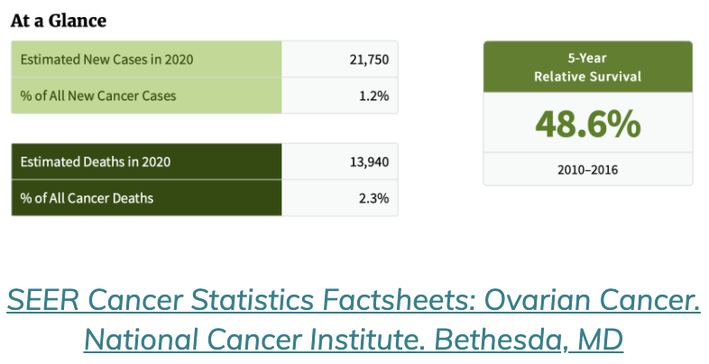
Background – Recurrent Ovarian Cancer
Around 85% will have recurrence
Notes:
Approximately 22,000 women will be diagnosed with ovarian cancer by the end of 2020 with 75% diagnosed at late stages. Despite aggressive surgery, the five year survival rate is less than half. 85% will experience a recurrence within two years.

Slide 4
Background – Problem
Background –Problem
On average, women receive 4 different lines of chemotherapy for advanced disease; complex and aggressive treatment regimens can lead to multiple and severe symptoms (e.g., pain, neuropathy, chemo brain)
The process of trying to manage multiple symptoms can be an overwhelming and time-consuming task for both patients and health care providers (HCPs).

Slide 5

Background – WRITE Symptoms
WRITE Symptoms was a 3-arm RCT (NR001735) of two web-based psychoeducation interventions to help recurrent ovarian cancer patients find new ways to get better control over their symptoms.
Intervention period was 8 wks.

Slide 6
Background – SD WRITE
Self-directed arm: an interactive web-based intervention guided the patient through the intervention elements on each of the 3 symptoms patient chose. Reponses were recorded verbatim.
Dependent variable: 3 items for each symptom addressing the extent to which the person believes that they can control the symptom on a 5- point Likert-type scale of 0 (strongly disagree) to 4 (strongly agree).

Slide 7
Findings of SD WRITE
SD WRITE groups showed significant symptom controllability increase from BL to 8-weeks (Mean change = 0.180, SE = 0.048, p < .001 )
We observed variable symptom controllability change among participants, suggesting only portion of participants obtain the benefits of the intervention.

Slide 8
Delving into controllability
Delving into controllability
To understand the psychological processes underlying perceived symptom controllability change and potential help clinicians identify the linguistic signals, I am inspired to explore the potential linguistic features that are associated with patient perceived control.

Slide 9
Methods -Data preparation and analysis
Merge & reshape dataset
SQR: ID, time of controllability assessment, symptom sequence [S1, S2, S3] and baseline and 8 week post intervention controllability scores
OEQ : ID, symptom and answers for the questions: 1. What does the symptom make you feel like; what's the cause?; what are the patterns?, 2. "How does the symptom affect you?" 3."Have you tried anything? Is it helpful?”
Metadata: ID and sociodemographics, including age, marriage status, employment, education, race, ethnicity.
9

Slide 10
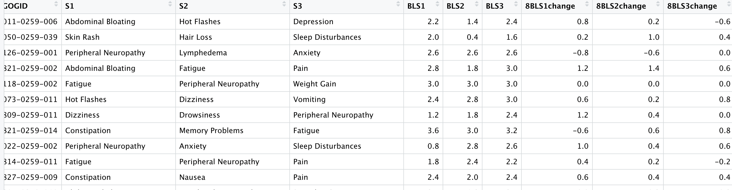
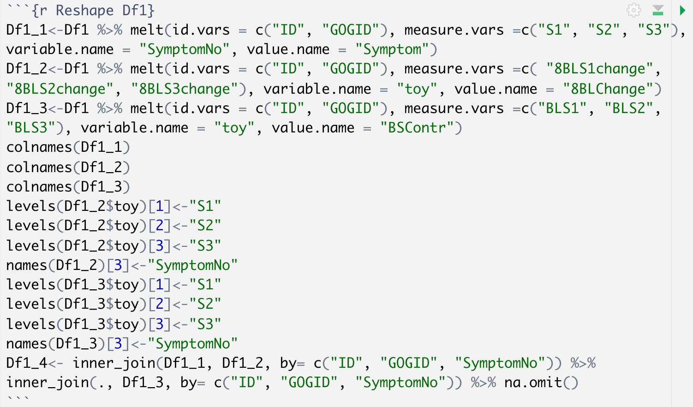
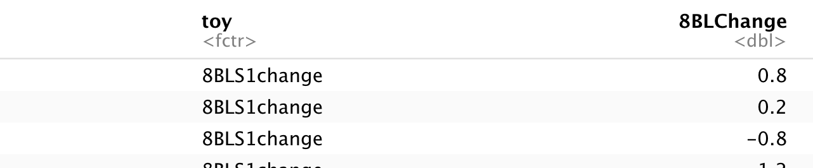
Df1
Df1_2
Notes:
I then Reshape Df1 into Df1_1, Df1_2, Df1_3 so that each participant have multiple symptoms, baseline symptom controllability scores, and score changes from baseline to 8 weeks.
Join these three subset together
Here is an example of Df1_2 after reshape.

Slide 11
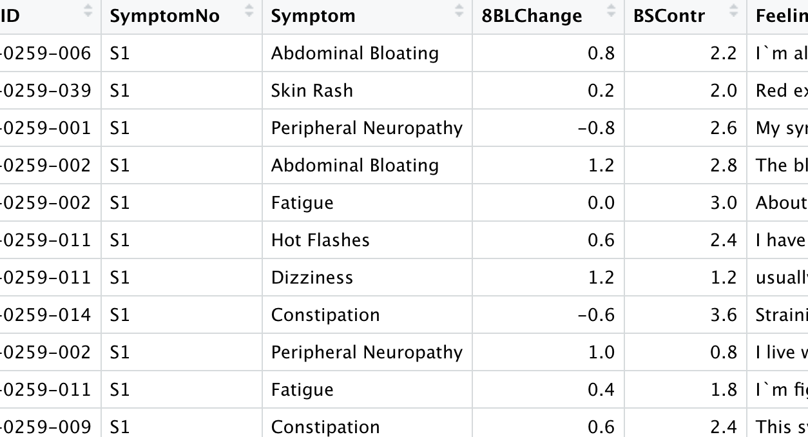
Merge with OEQ (text data) by Participant ID and Symptom

Slide 12
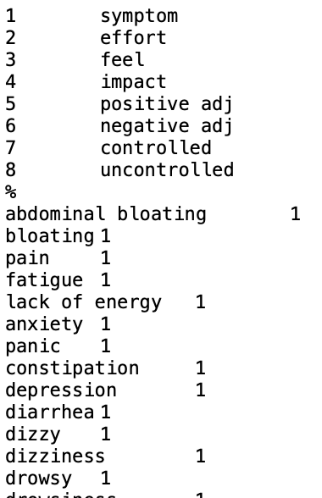
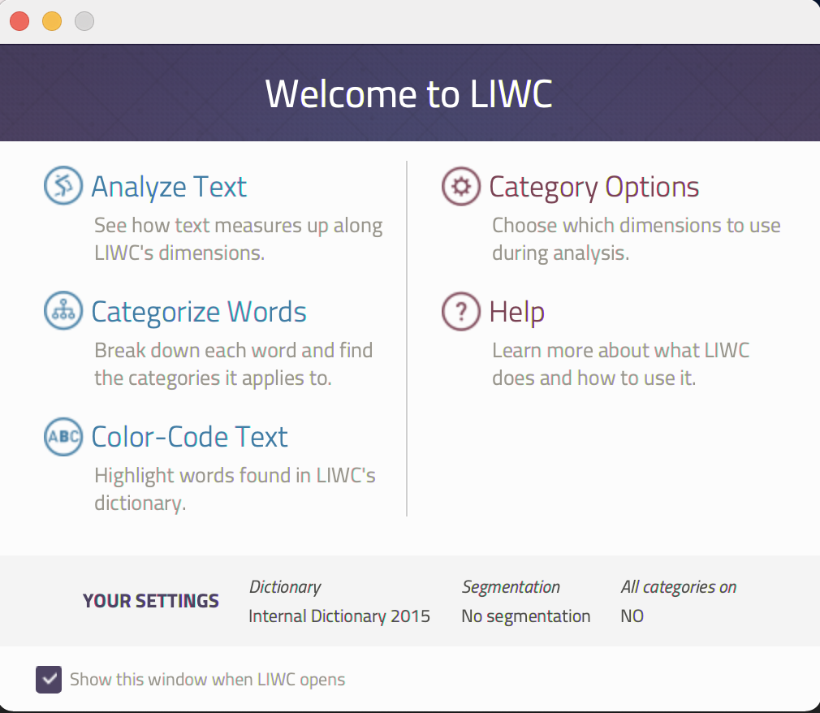
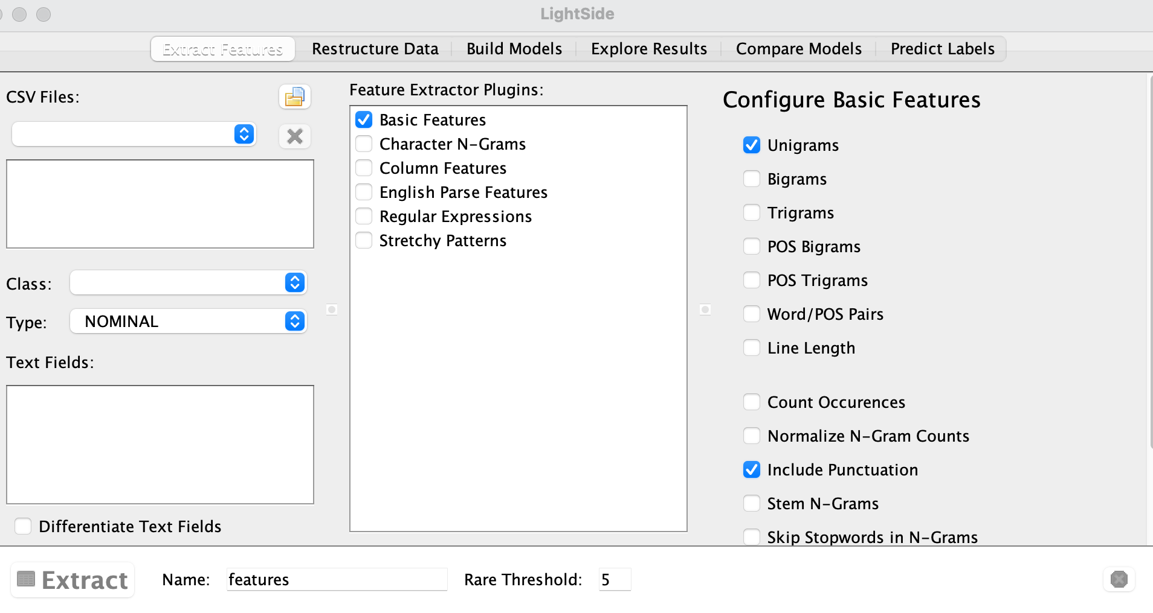

Data analysis– feature extraction
12

Slide 13
Data analysis
Linear mixed effects model
Random effects: participant ID
Covariates: participant social demographic factors, e.g., marriage status, age, education, employment
Fixed effects: baseline symptom controllability score and individual linguistic features or new predictors created by PCA on all the individual linguistic features
13
Notes:
Didn't use race or ethnicity because patients were predominantly non-Hispanic white)

Slide 14
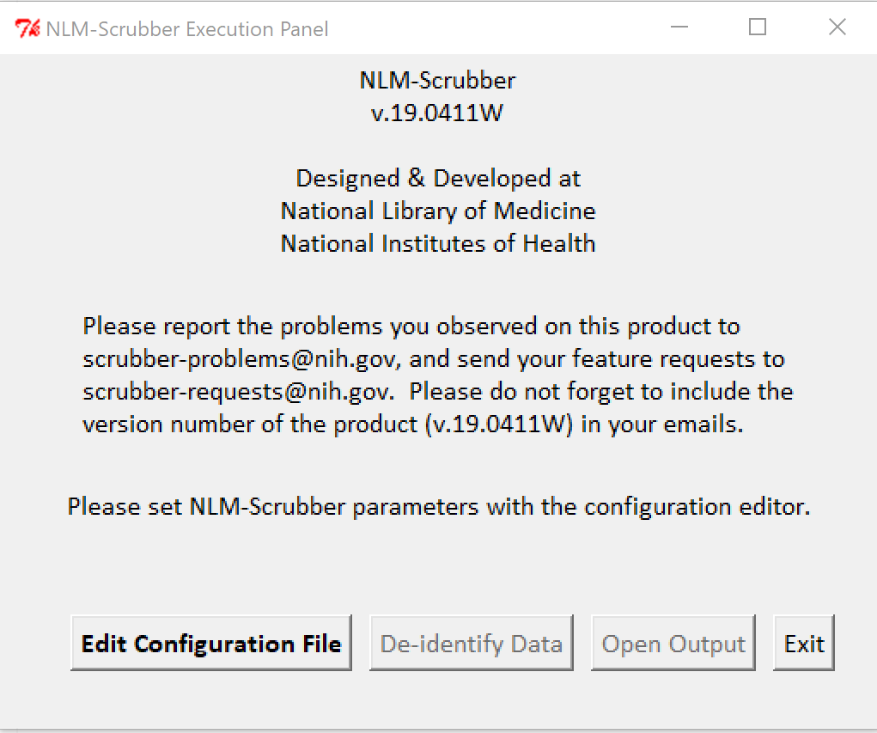

Data sharing plan
De-identify qualitative dataset
14
Notes:
For our dataset, it is still possible to reidentify individuals from deidenitfied data with the use of additional information linked to the same individuals. Data set can be shared upon request with data use agreement.

Slide 15
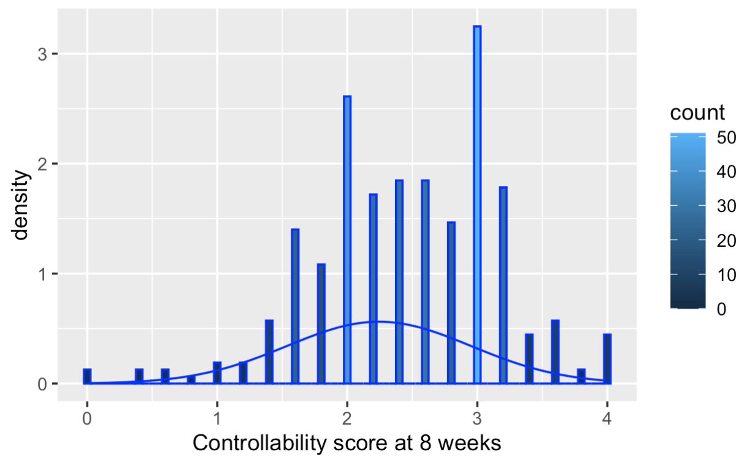
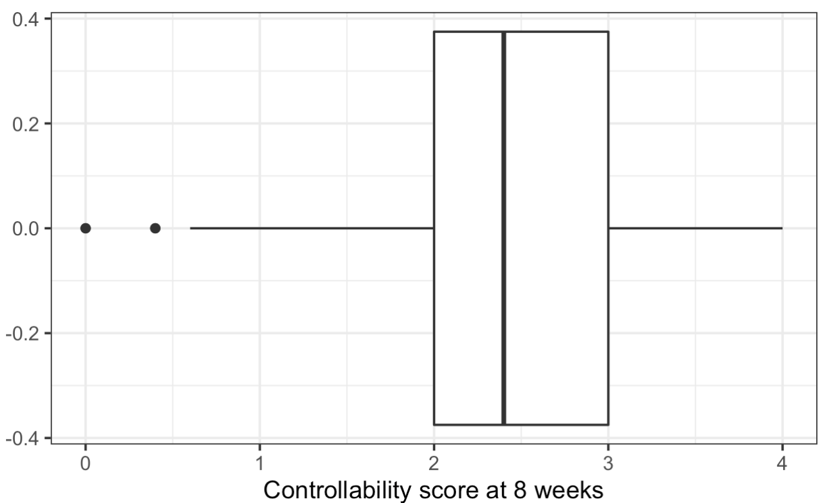
Results
Perceived controllability @ 8 weeks

Slide 16
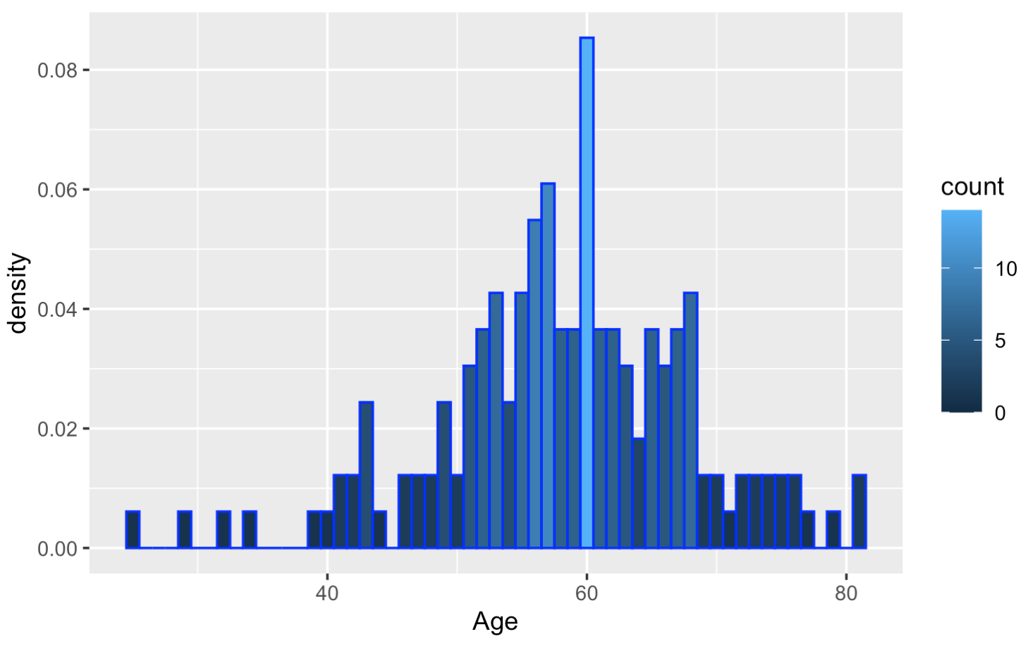
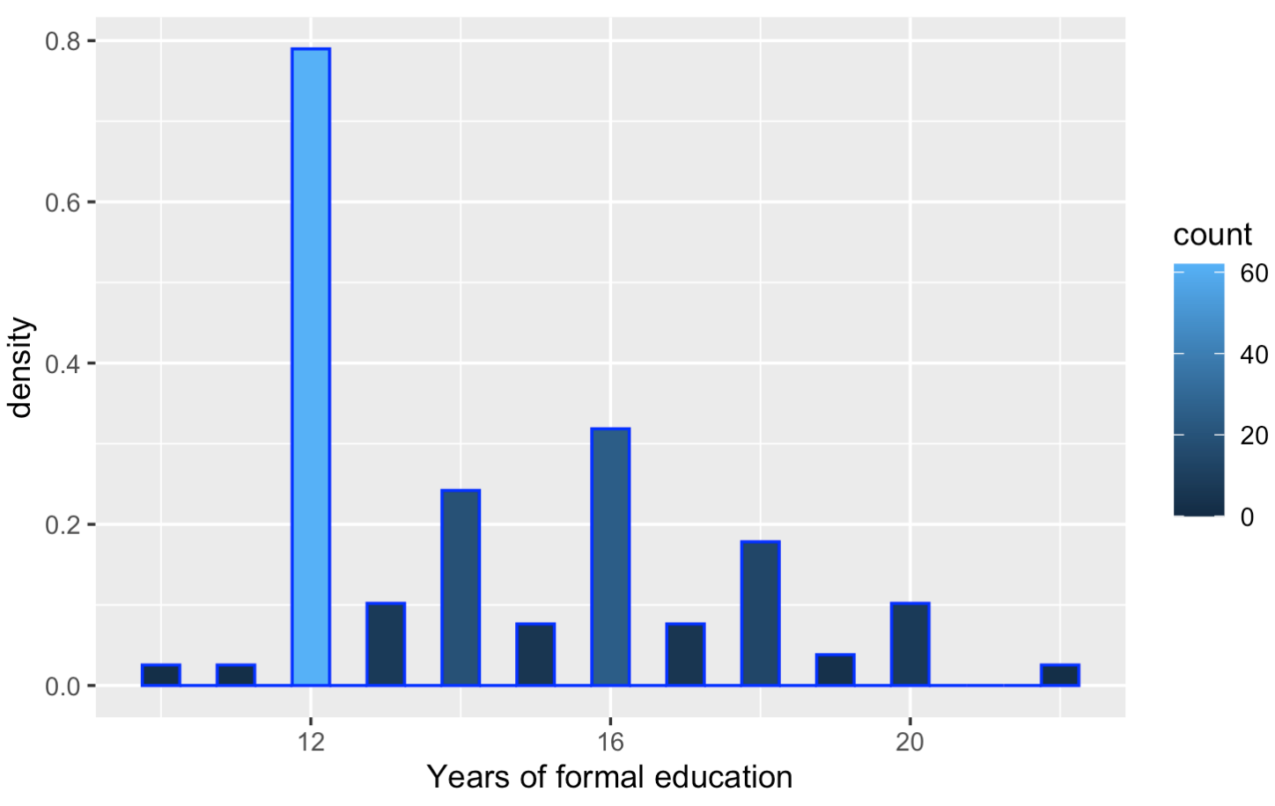
Participant sample
Predominately non-Hispanic(96.18%), White (93%), older(75.6%), and married or living with partner (75.16%)
Over half is employed (59.24%)
The mean of age is 58.18 (SD = 9.72). The average of formal years of education is 14.4 (SD=2.72)

Slide 17
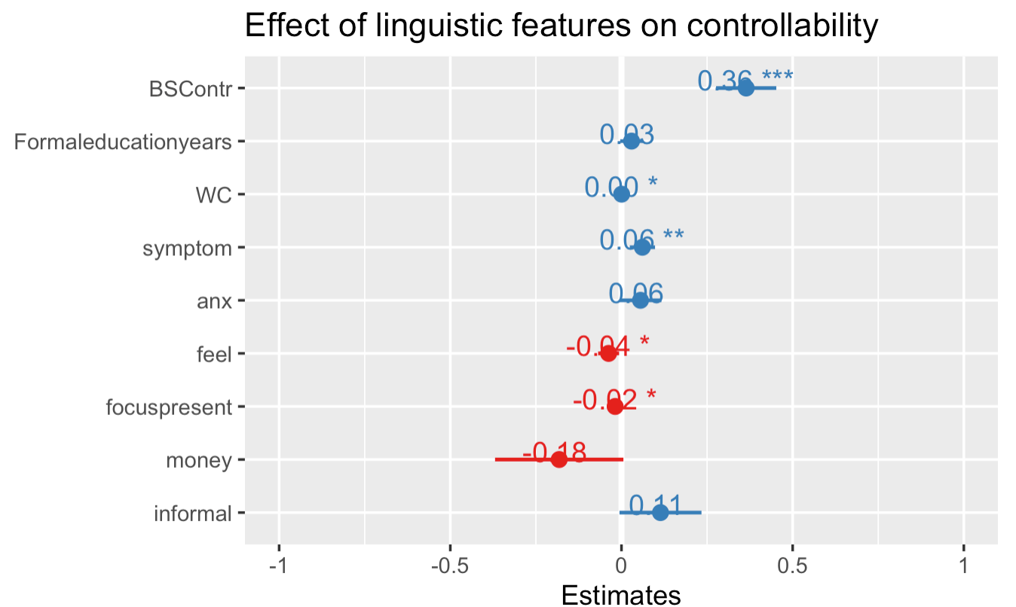
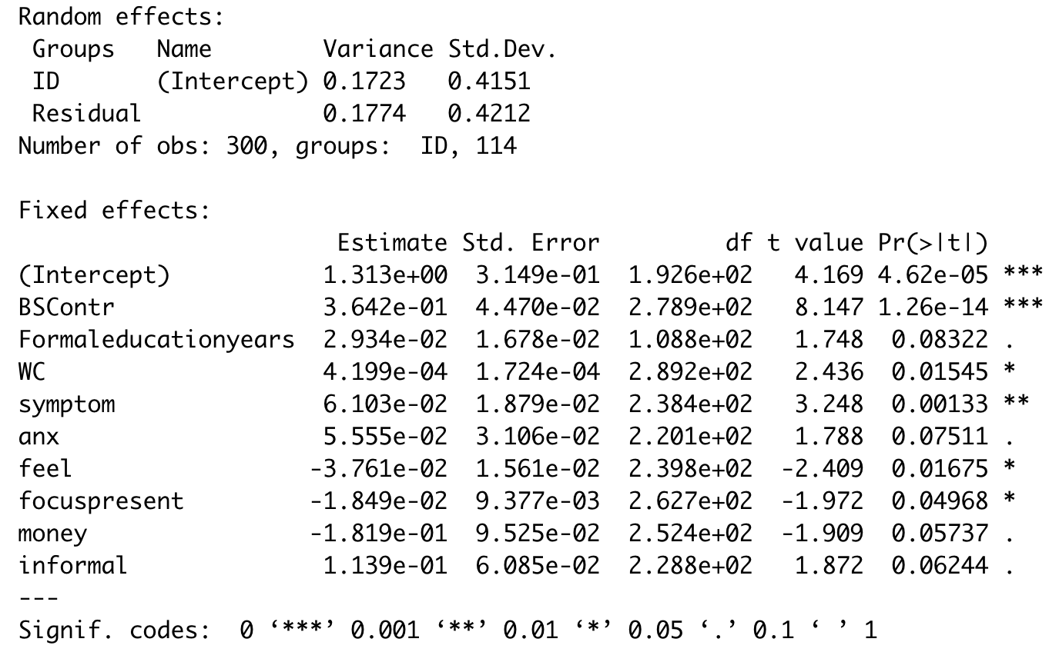
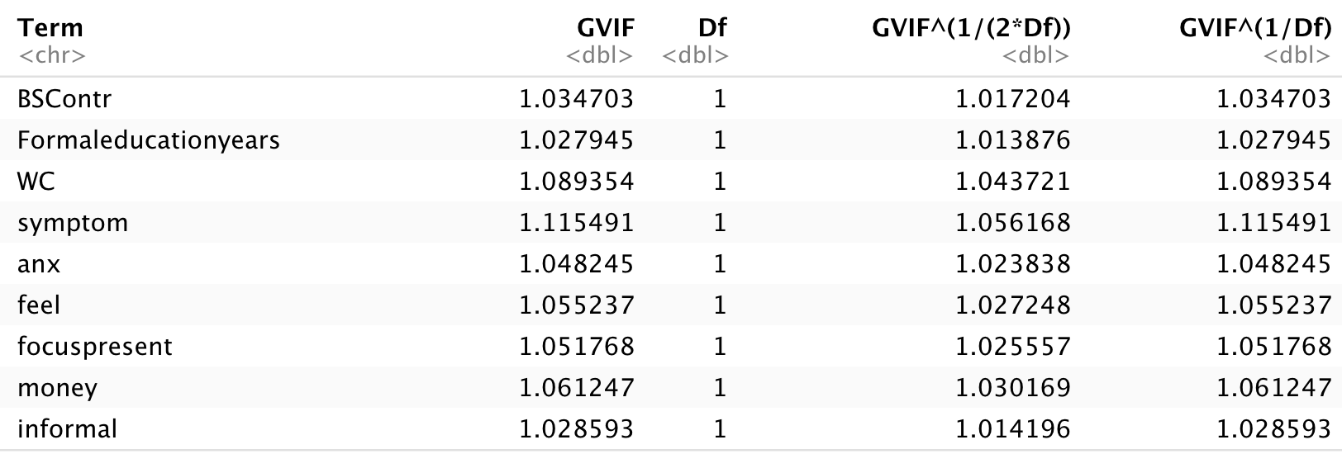
1. ID as random effects and individual linguistic features as predictors with opinionated forward selection

Slide 18
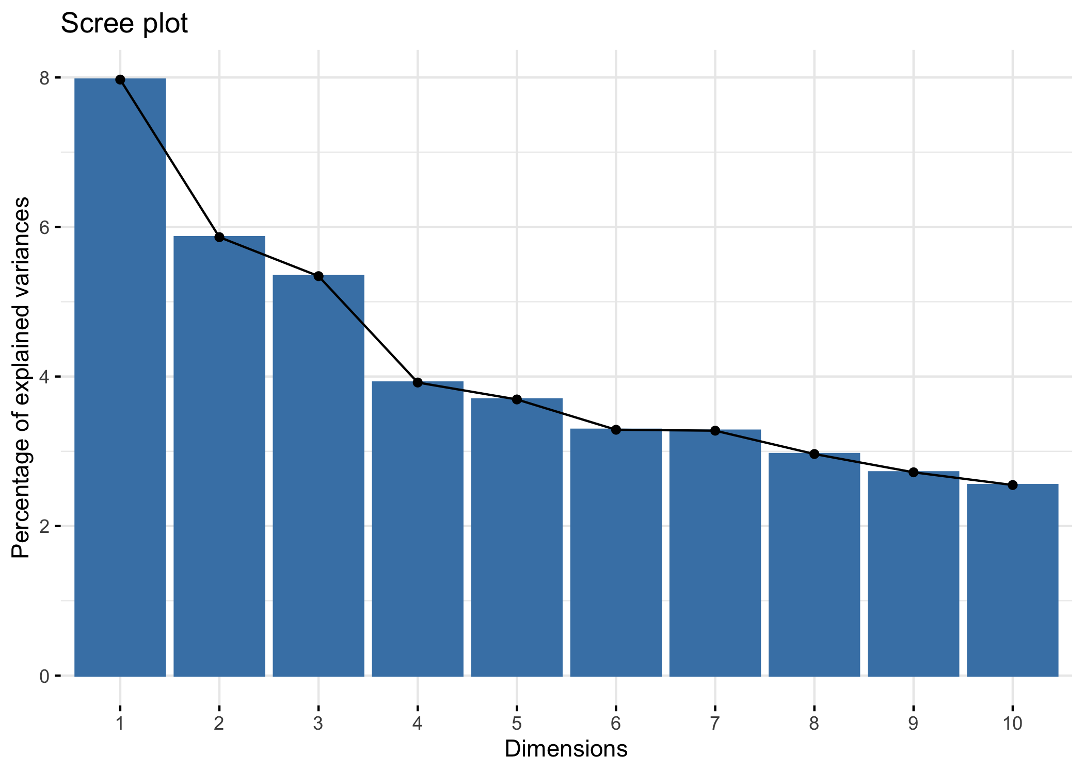
2.1 PCA on all the linguistic features
33 components have eigen values >1, explaining 76.8% of the variance in total

Slide 19
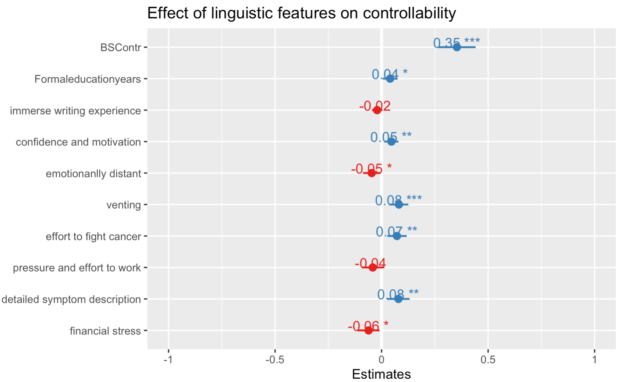
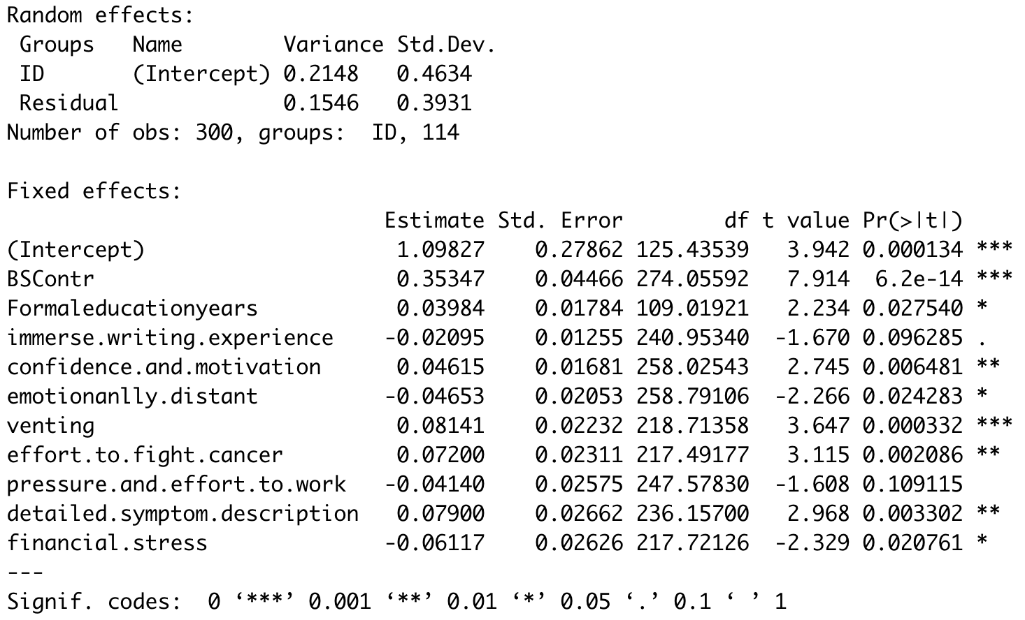
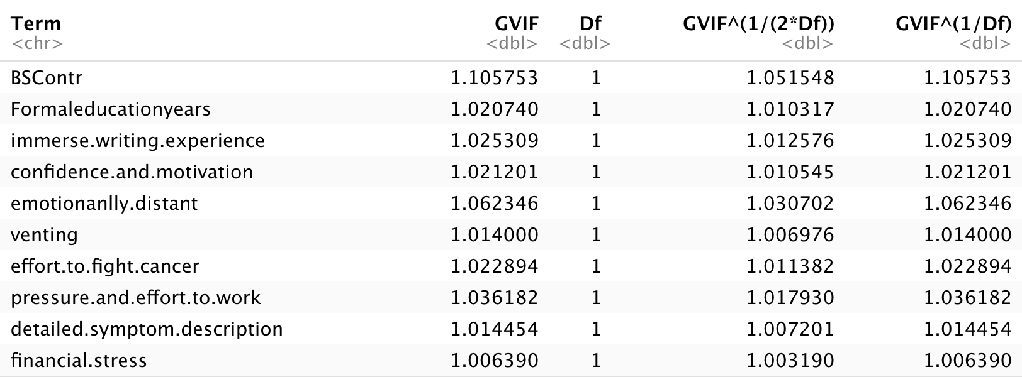
2.2 ID as random effects, principle components are fixed effects with iterative backward elimination

Slide 20
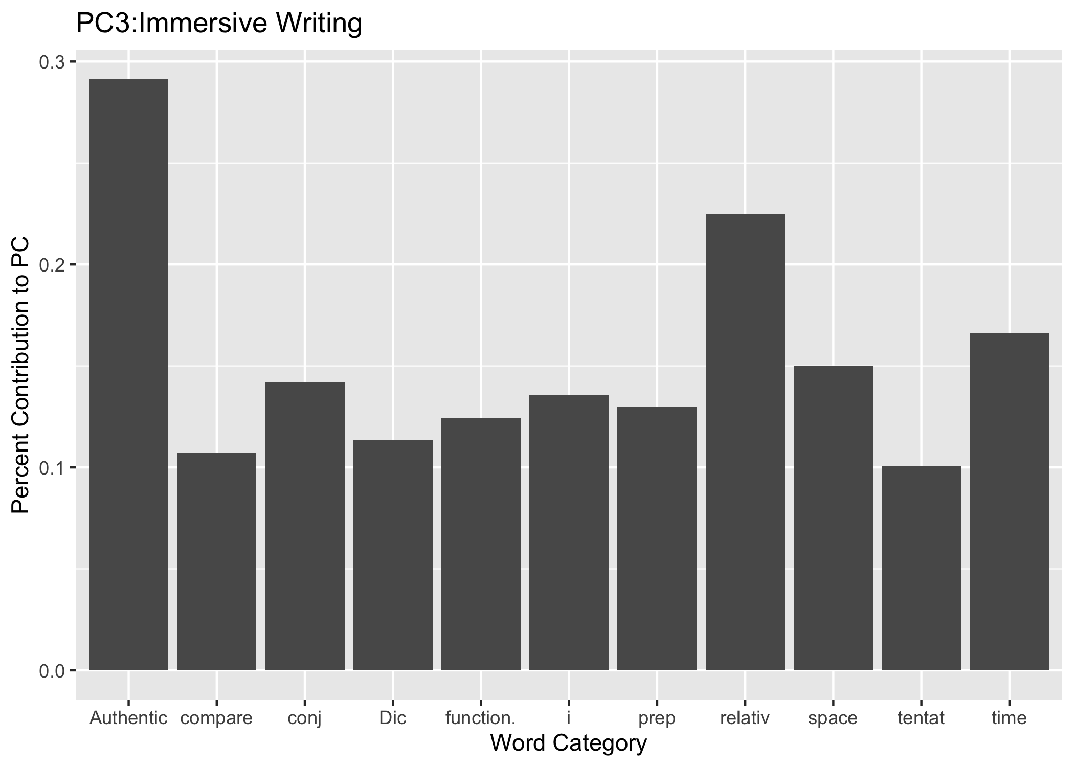
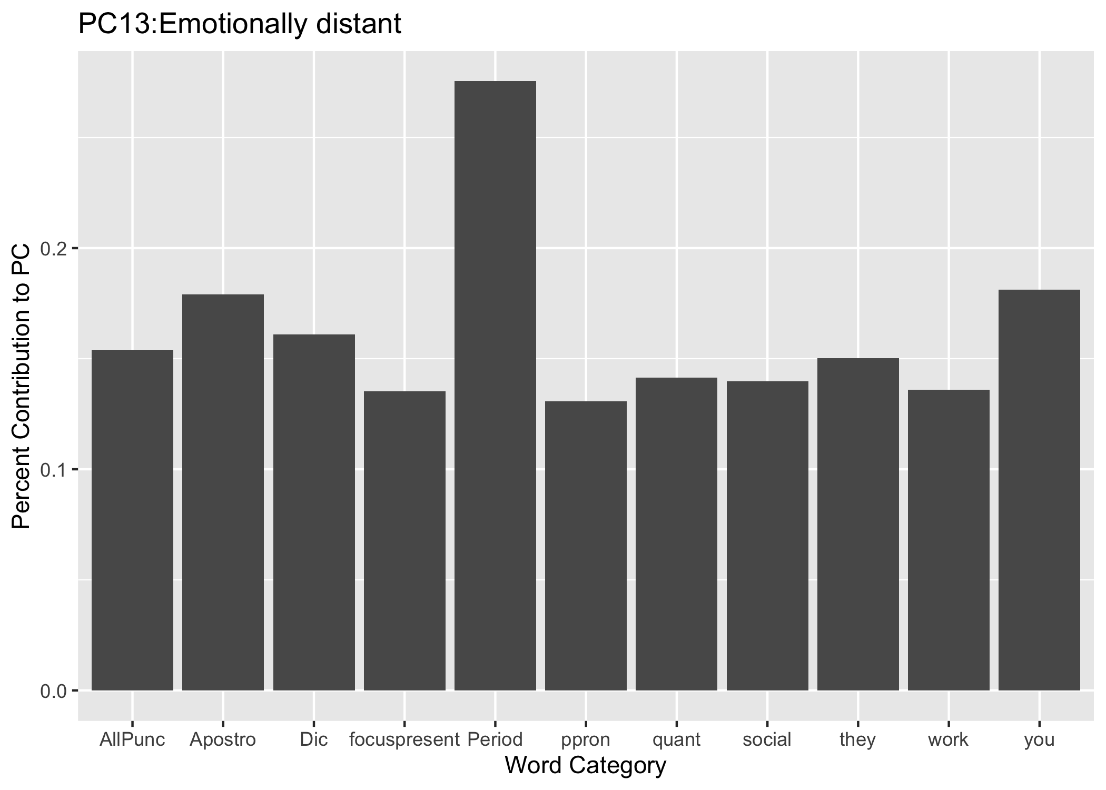
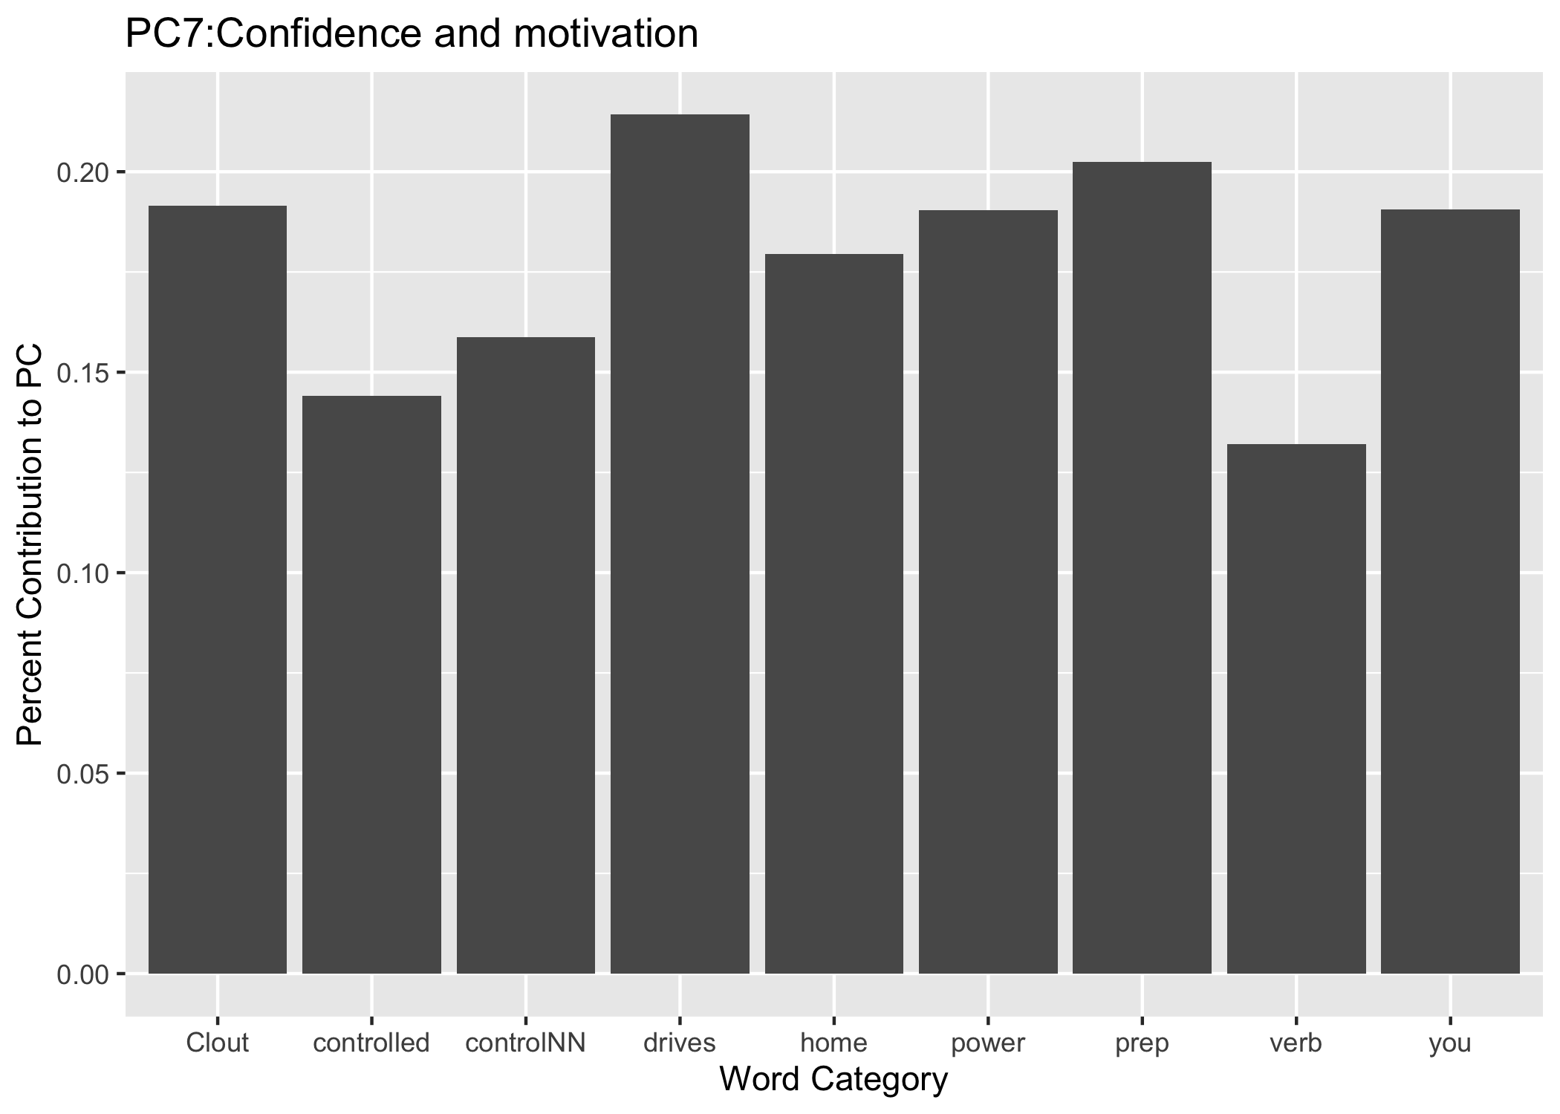
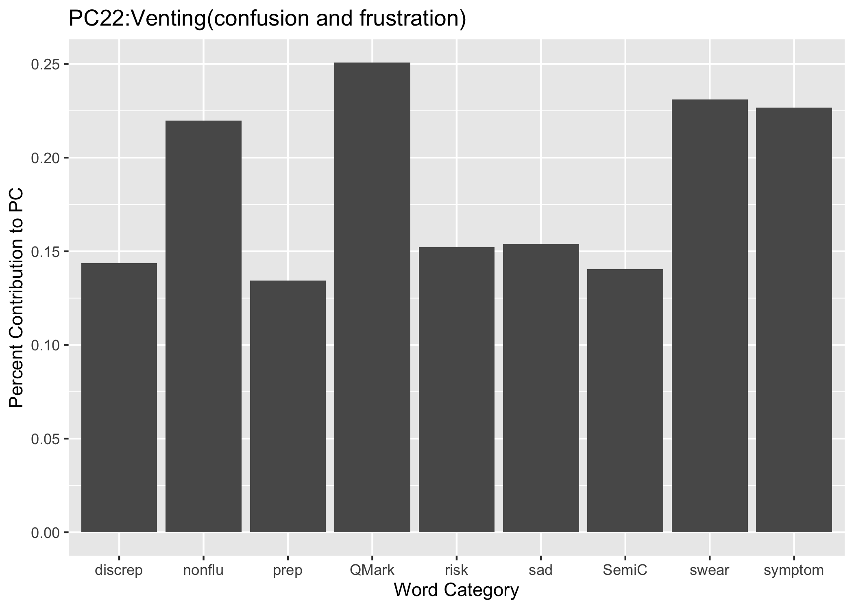
2.2 Contribution to the principle components

Slide 21
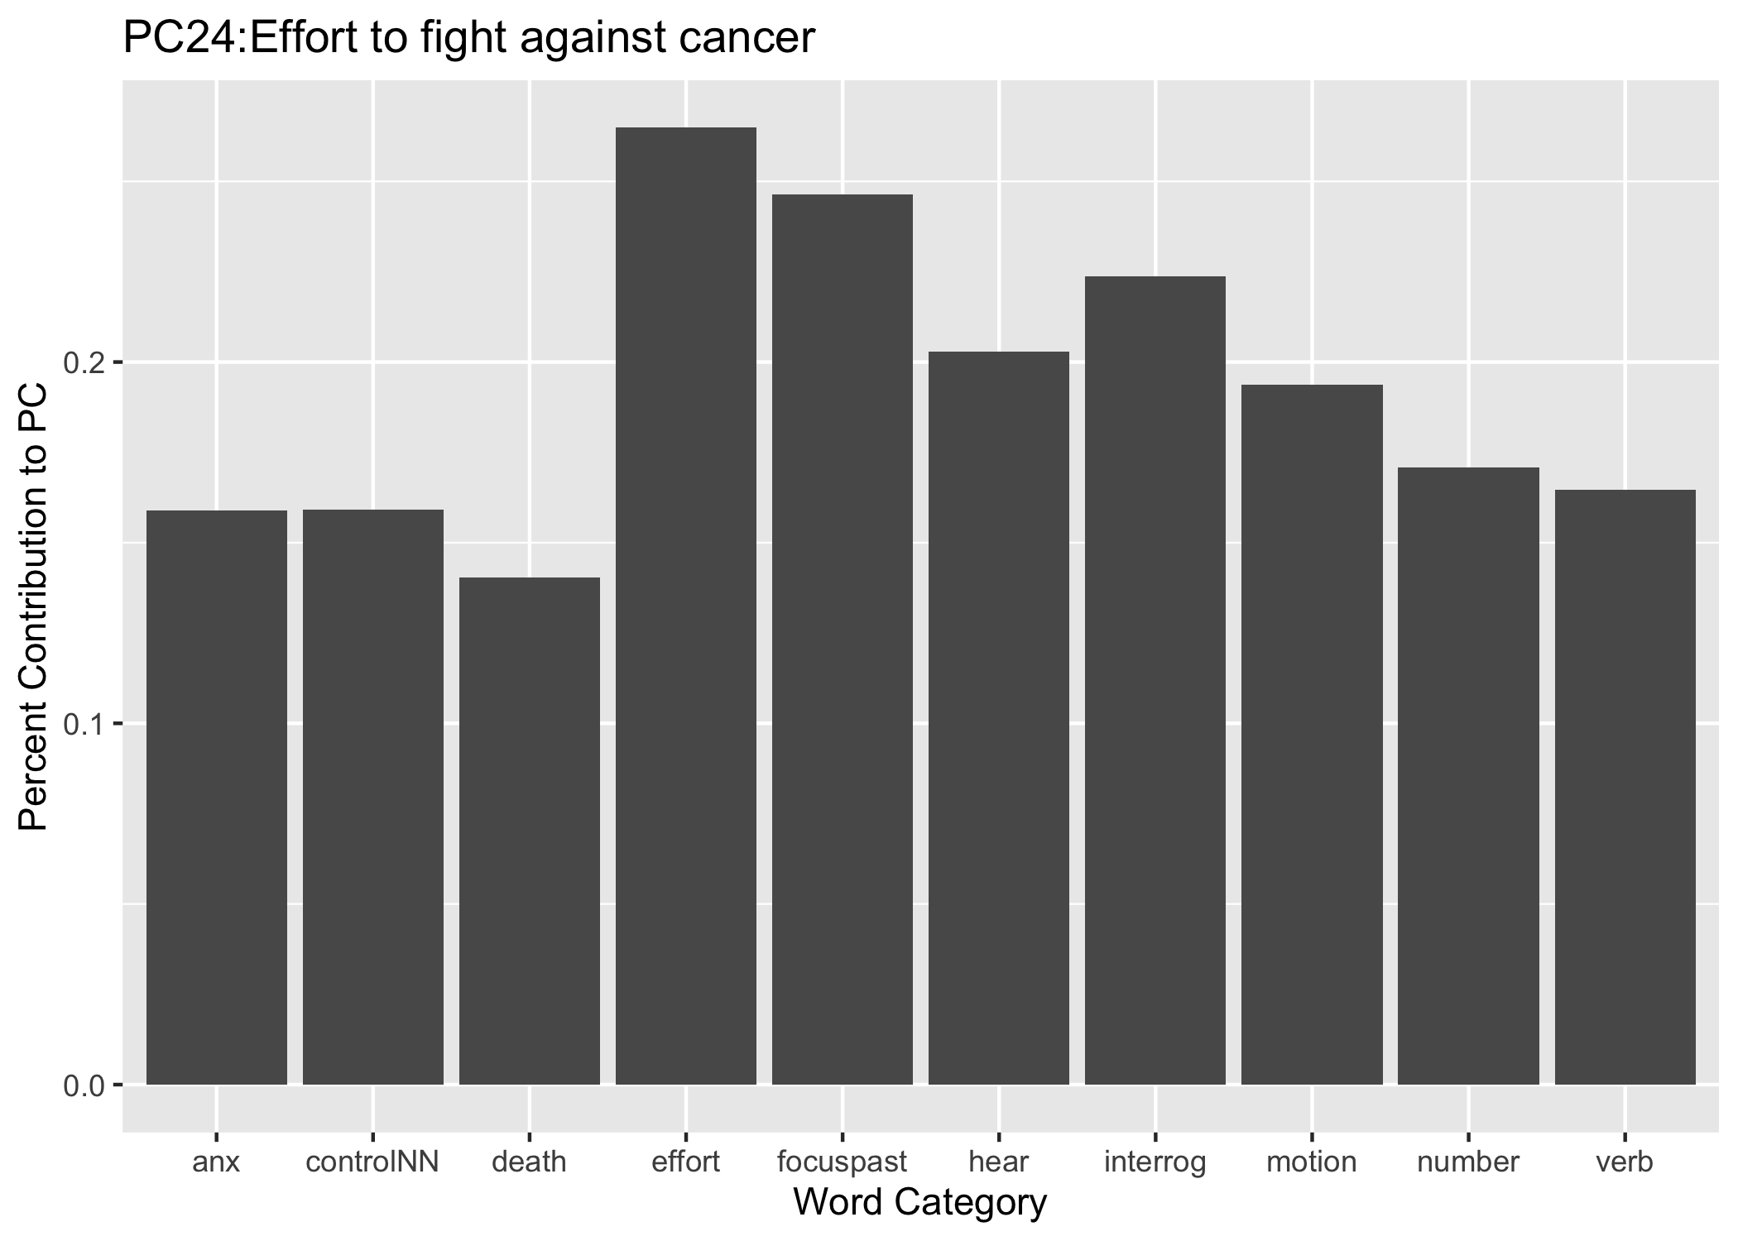
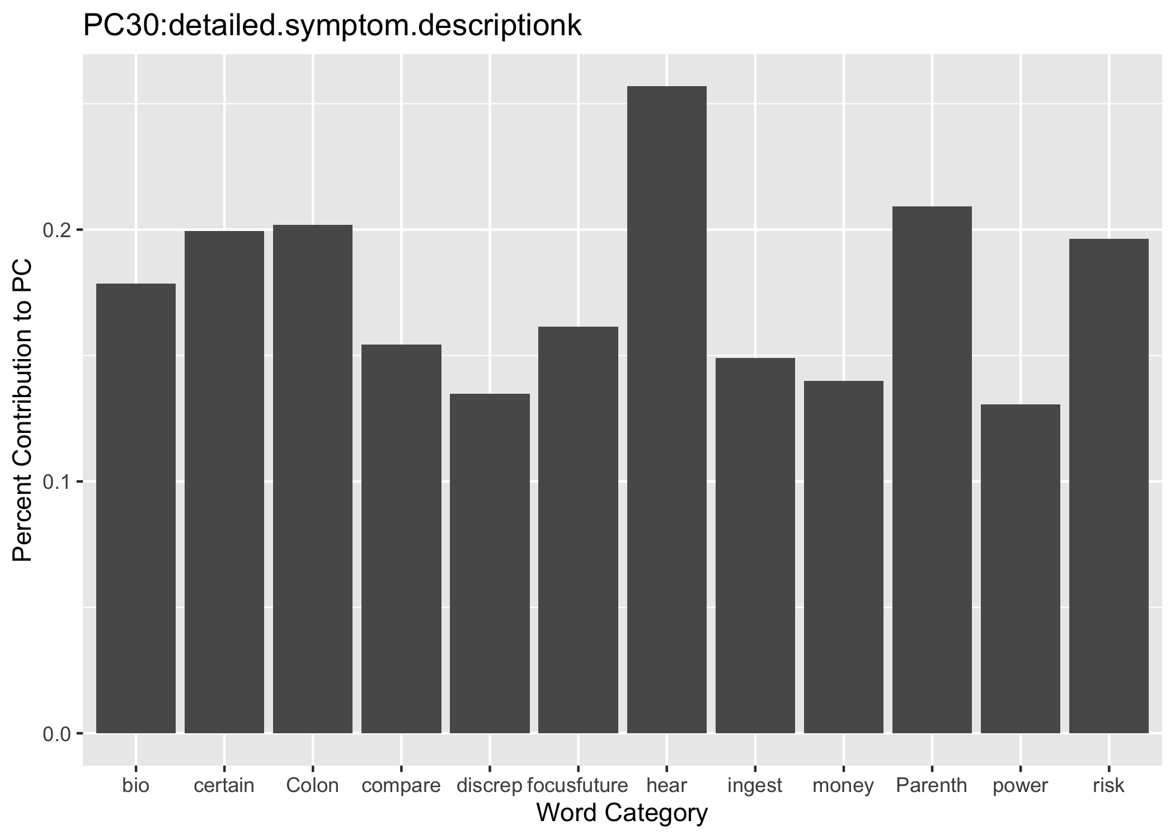
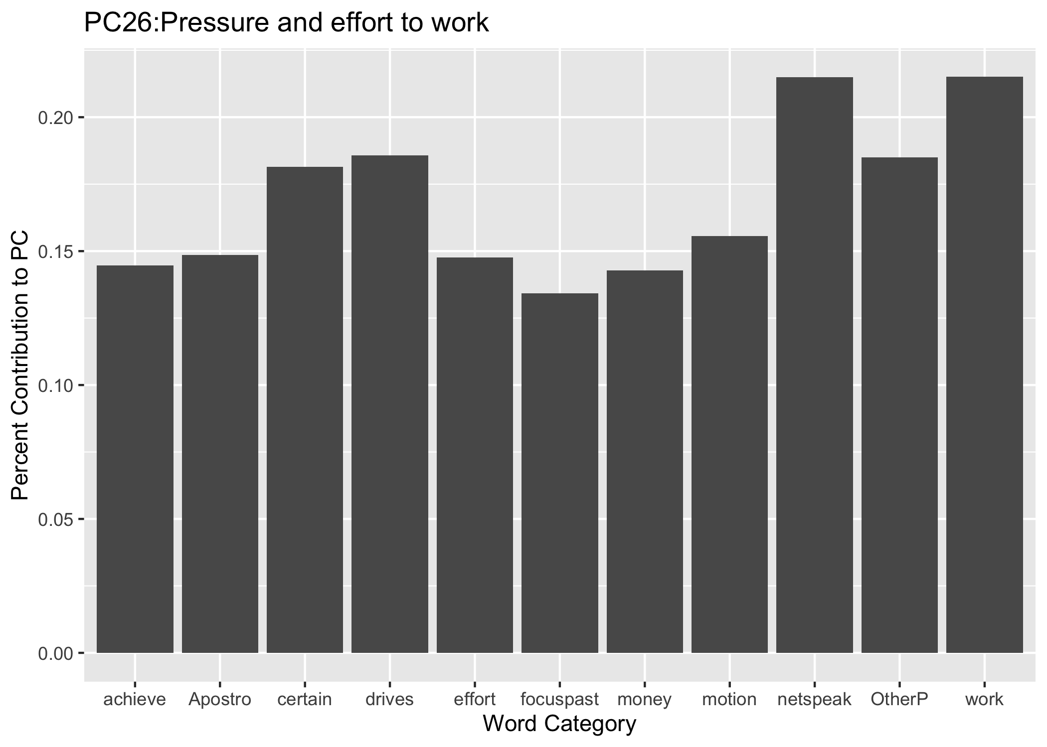
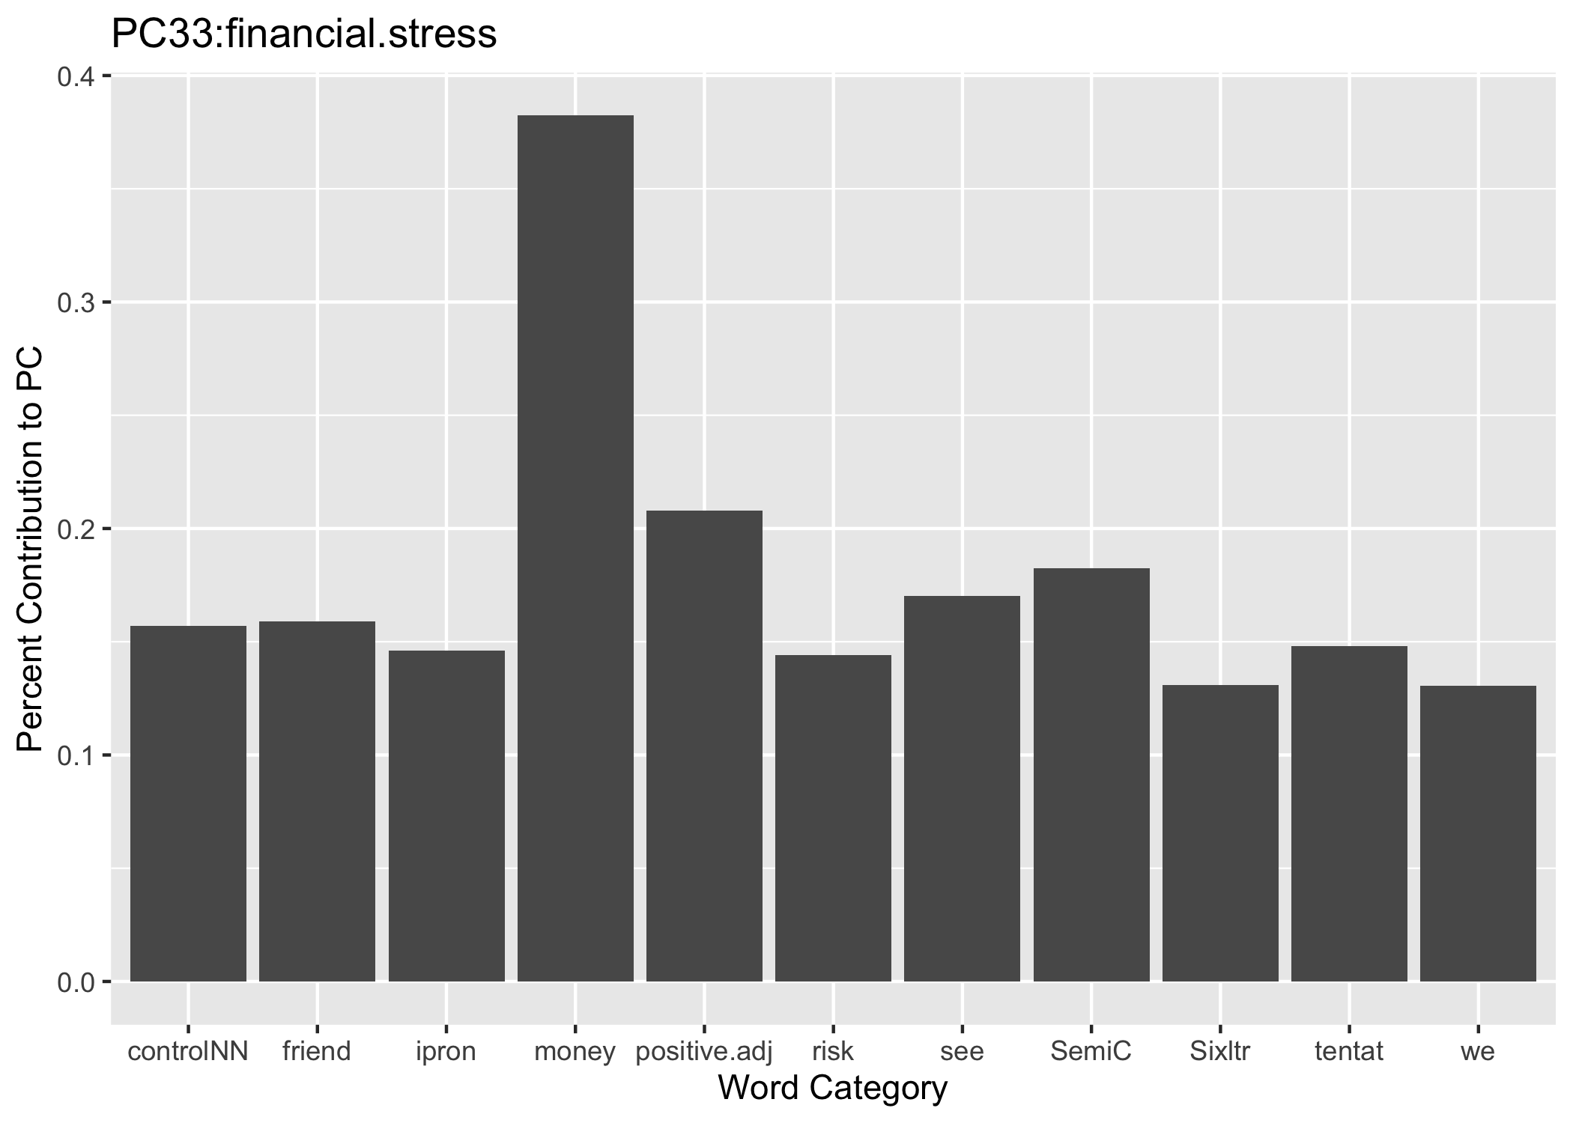
2.2 Contribution to the principle components

Slide 22
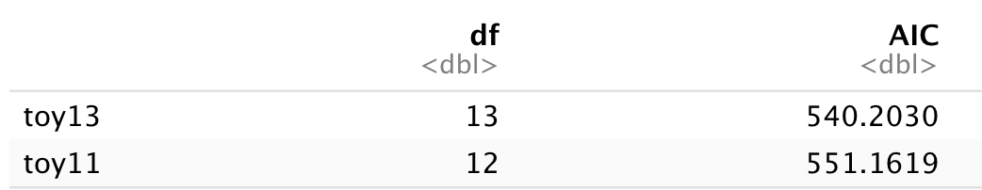
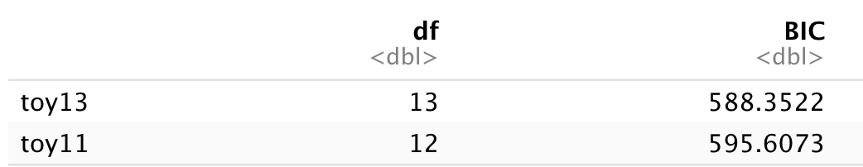
PC 7 and PC 23
3. Compare two models
Seems like model toy 13 is better

Slide 23
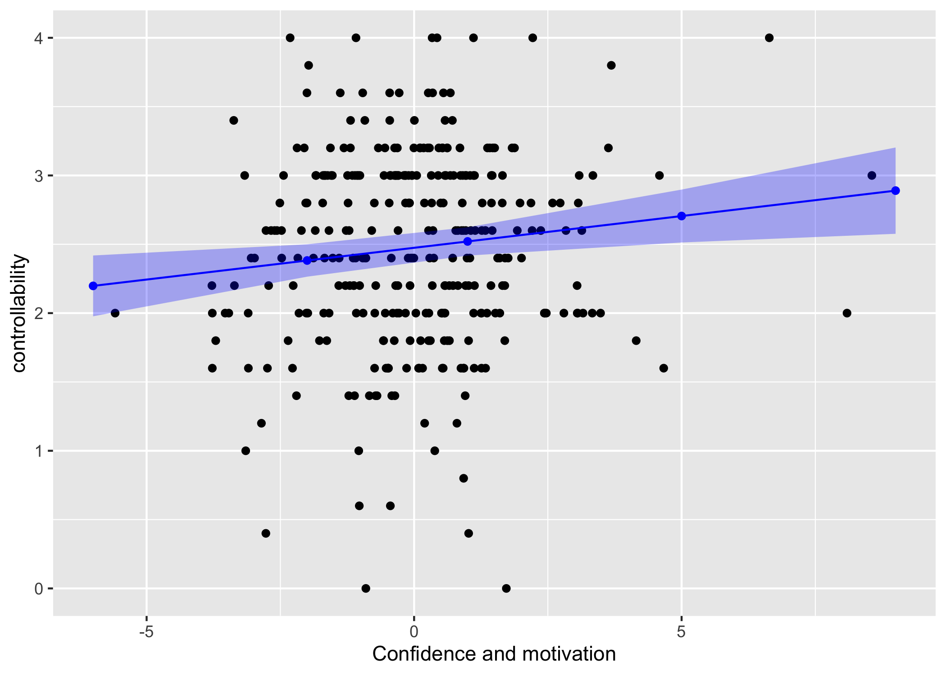
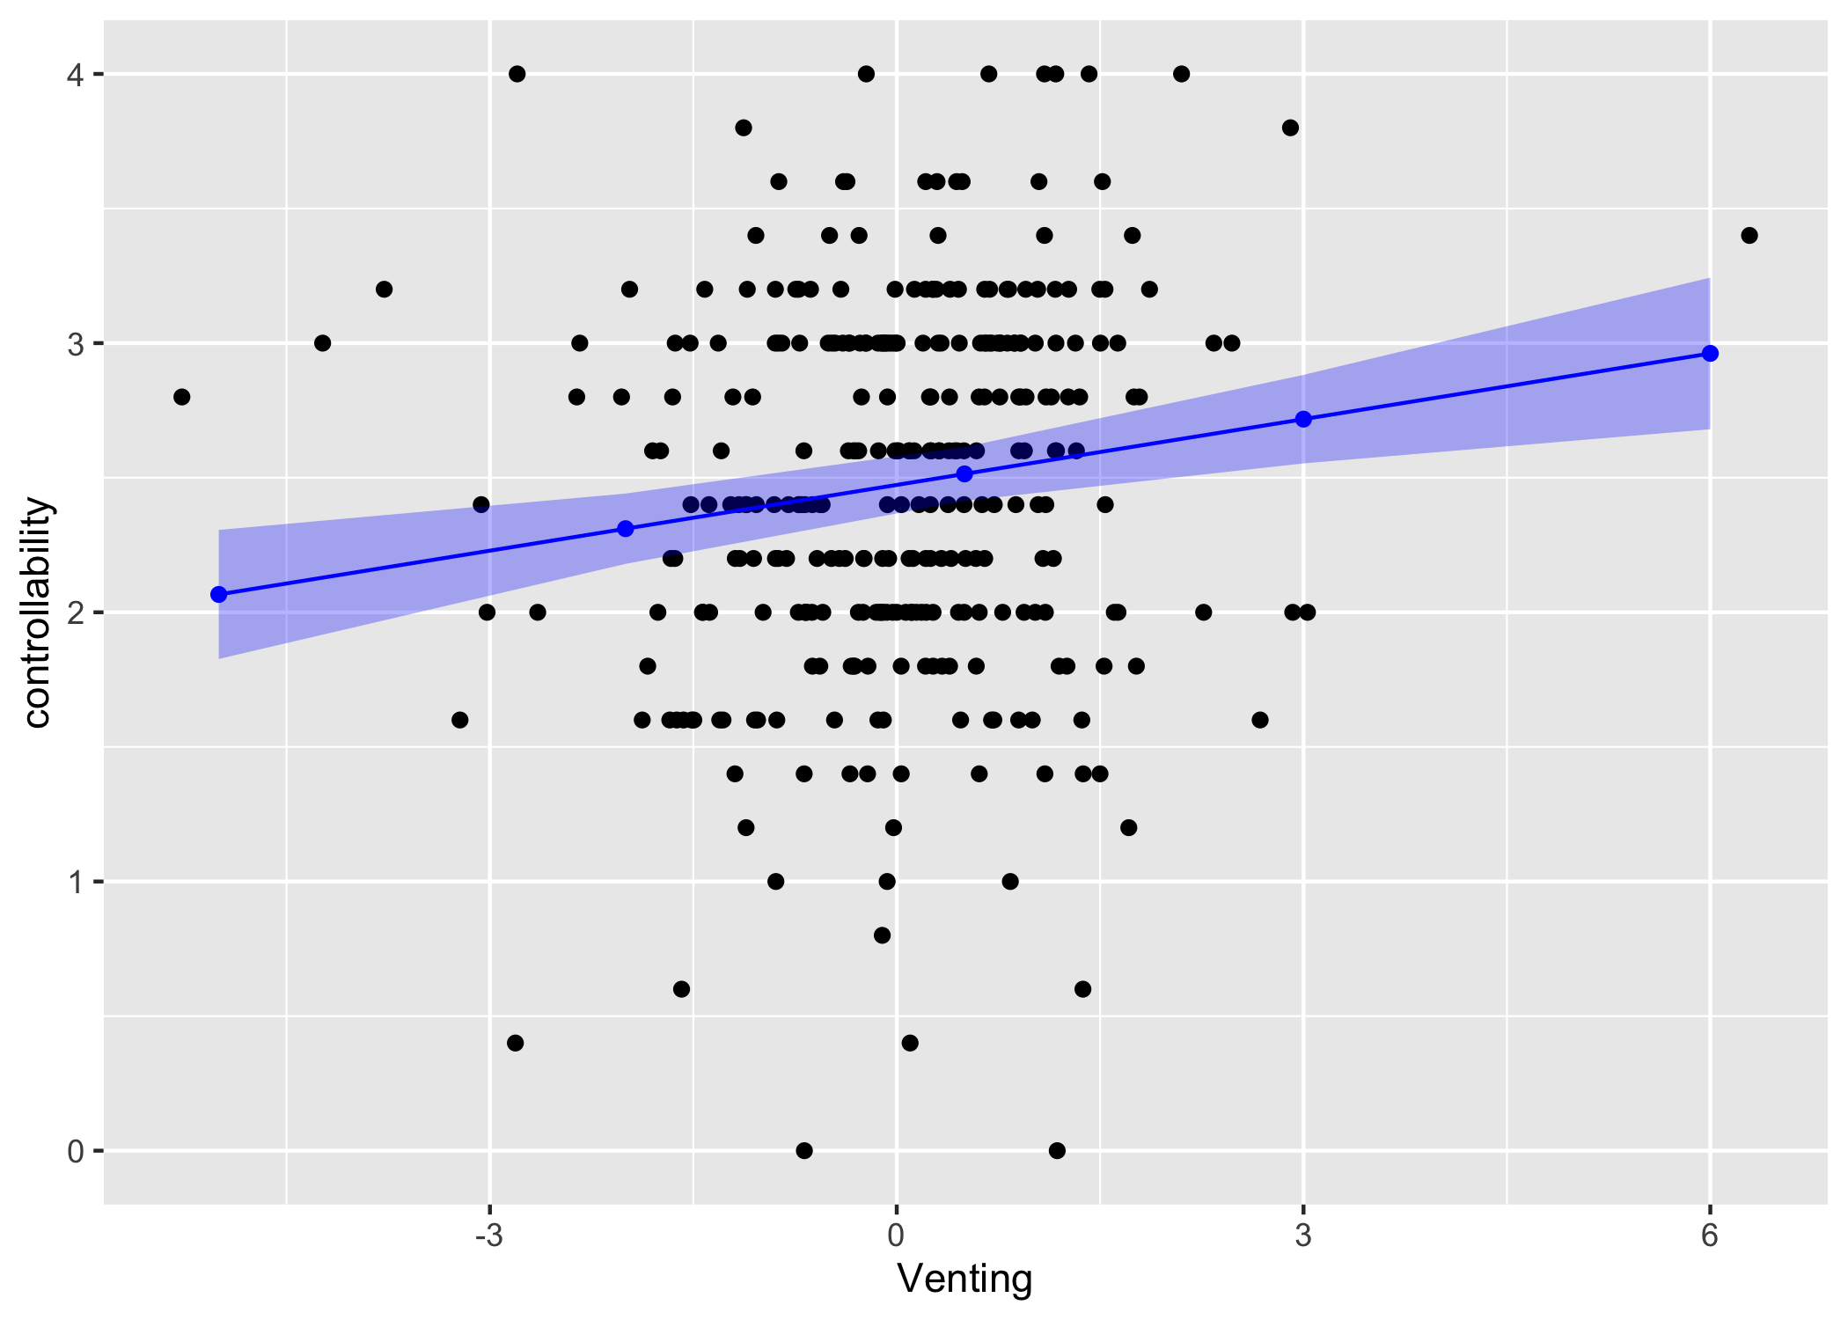
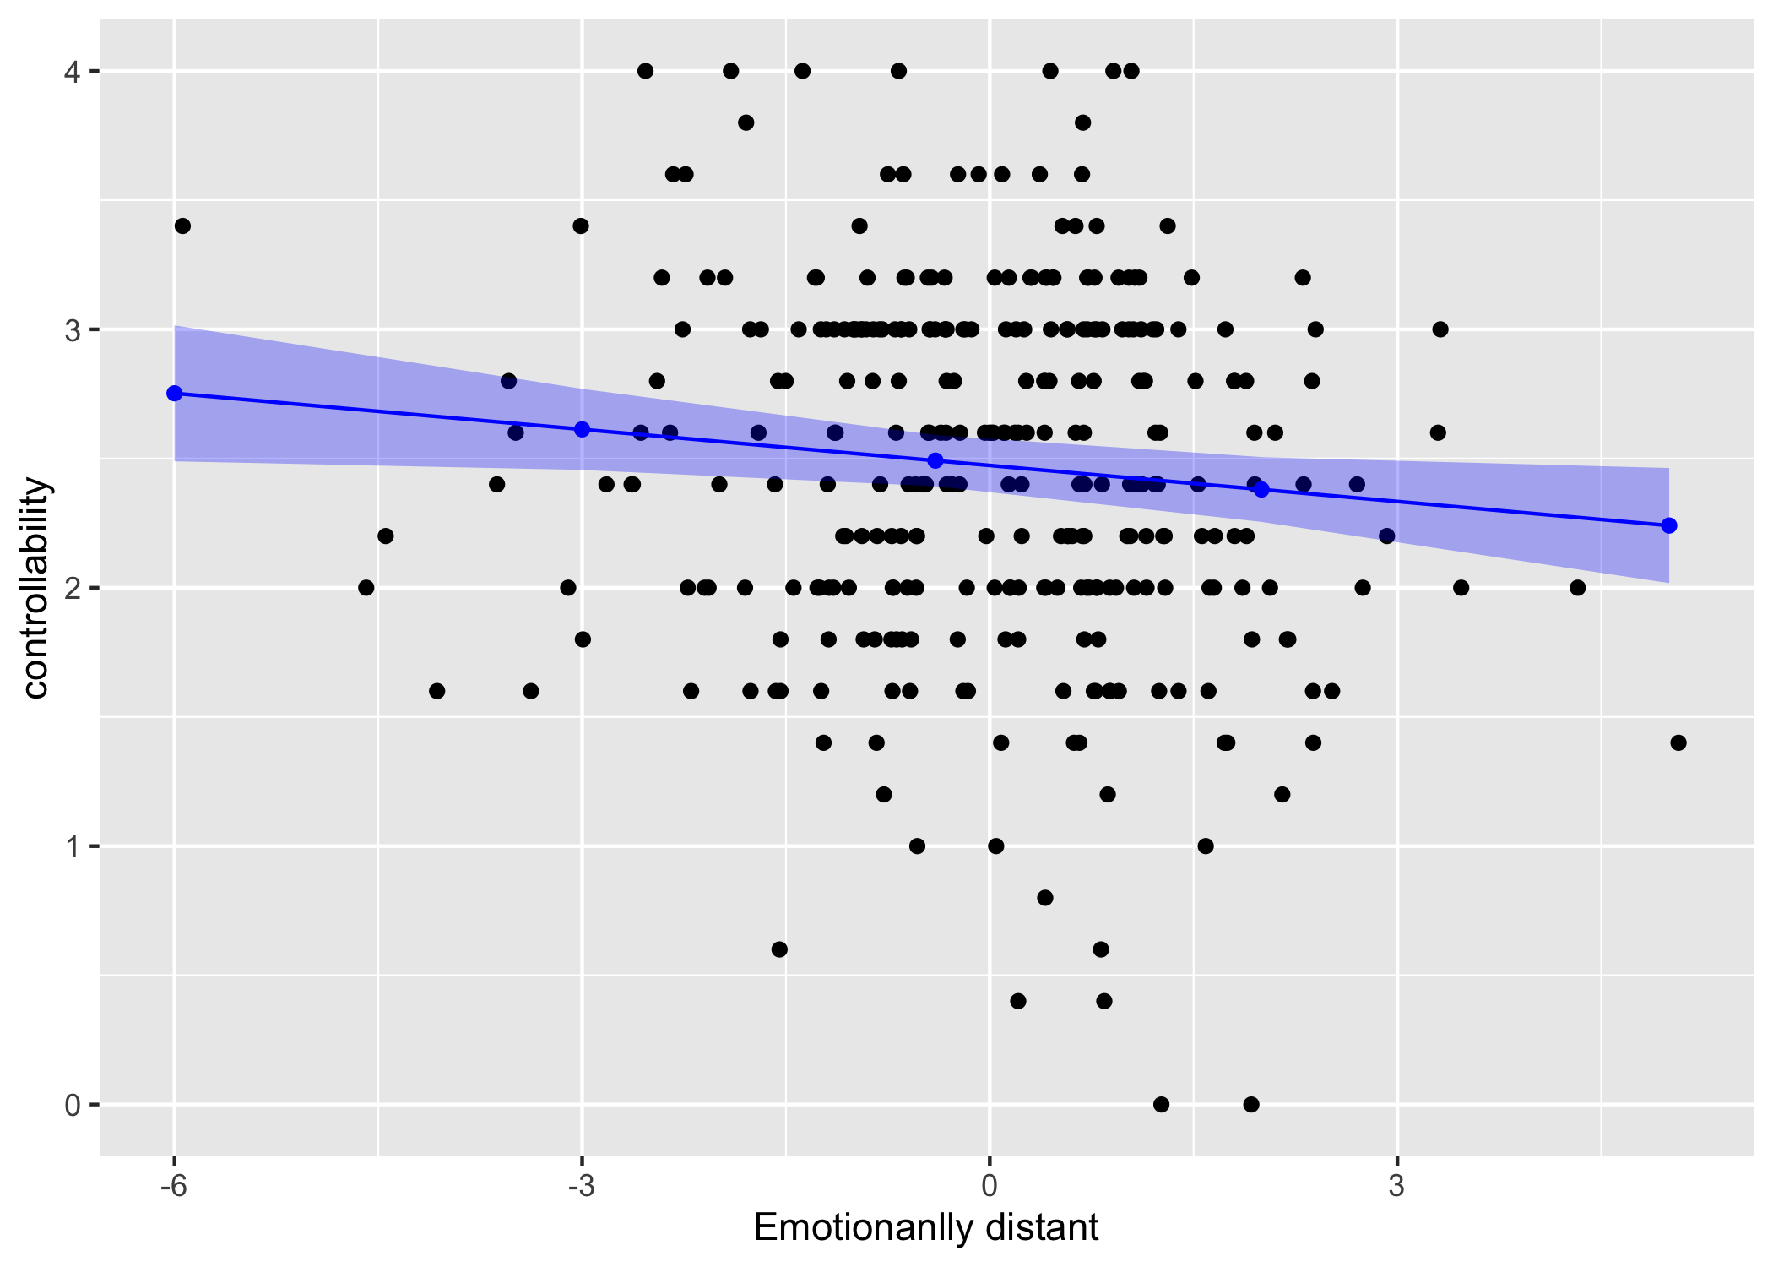
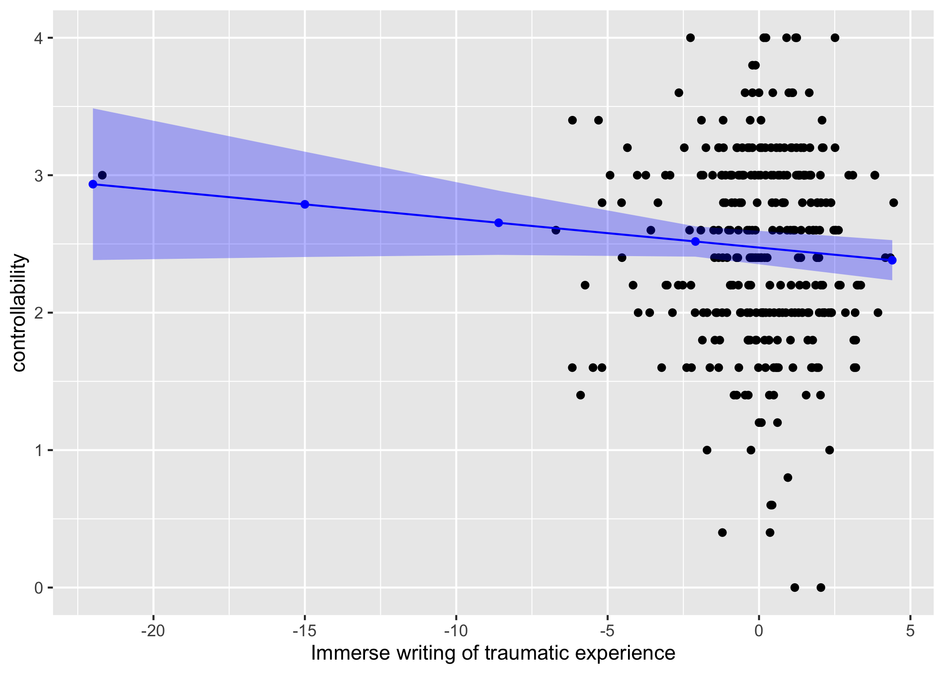

Slide 24
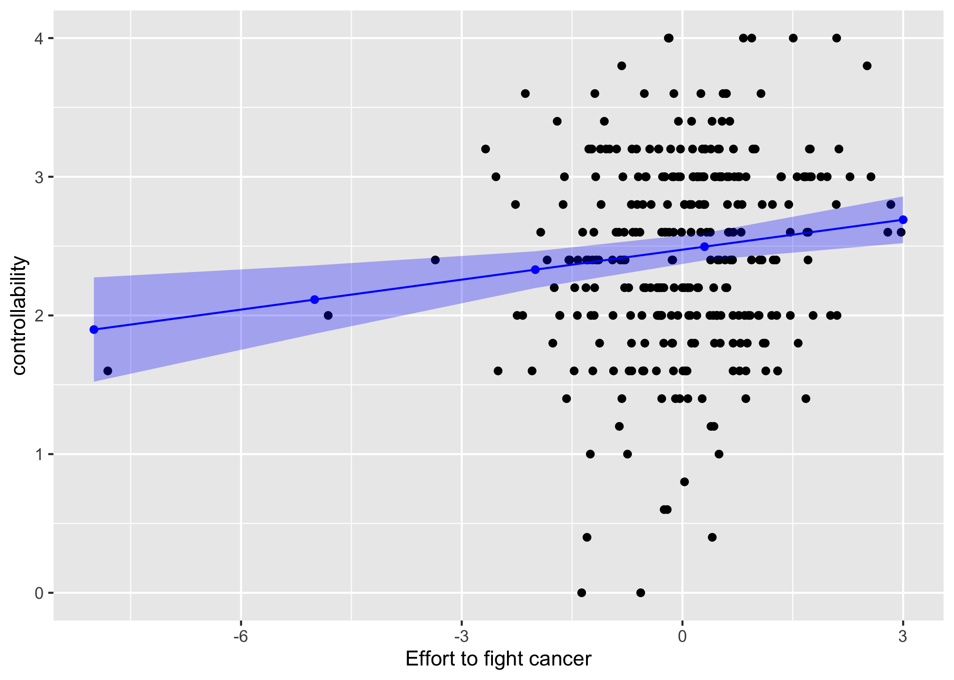
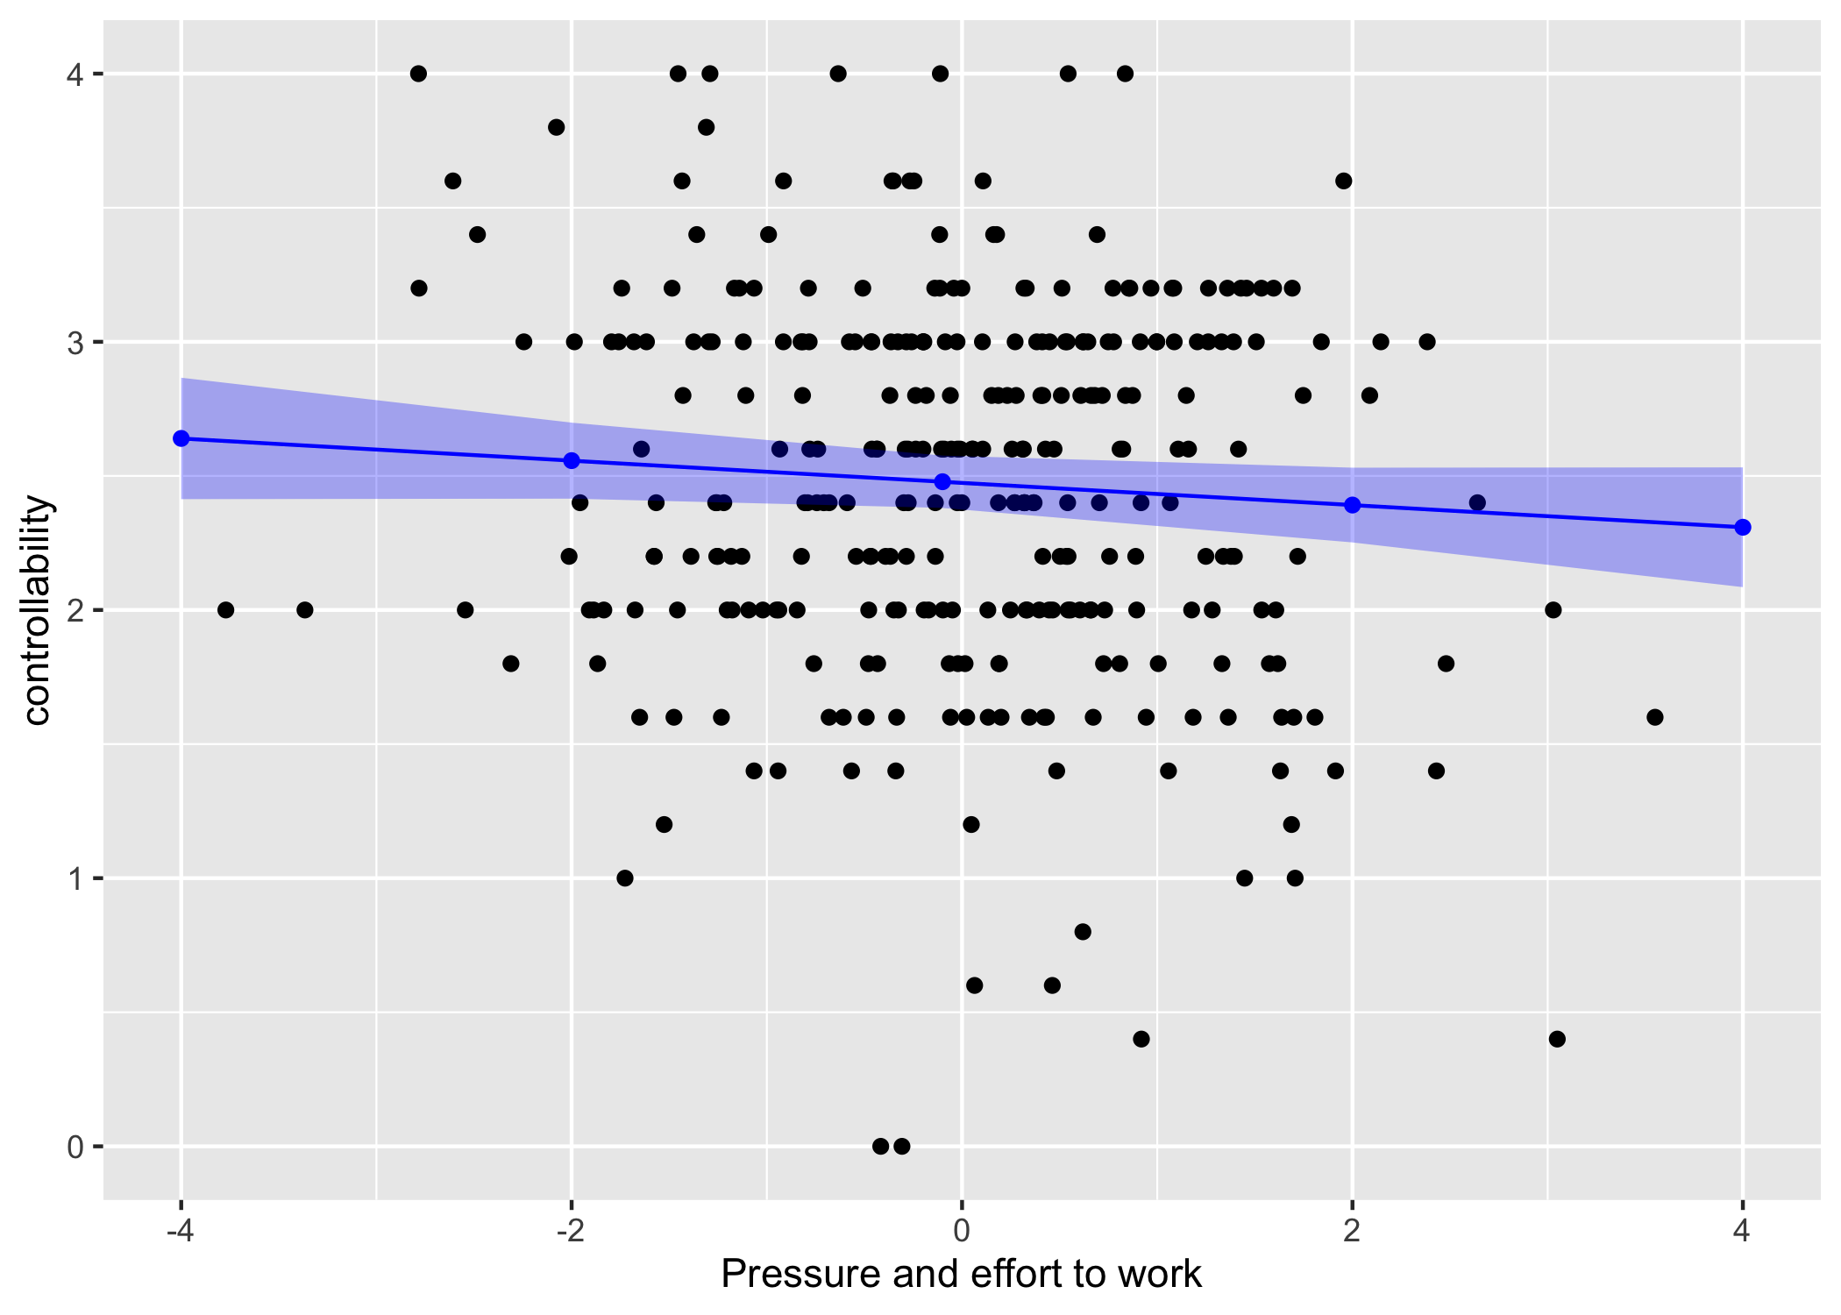
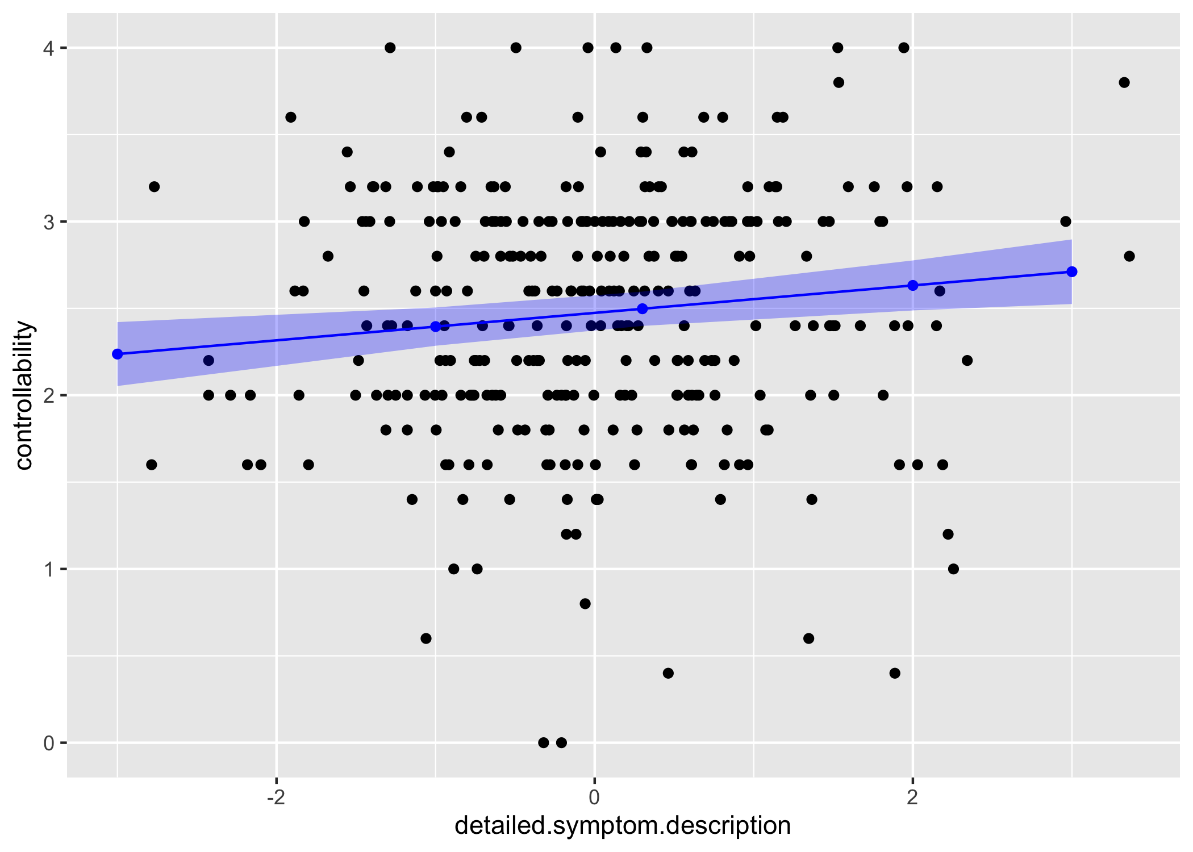
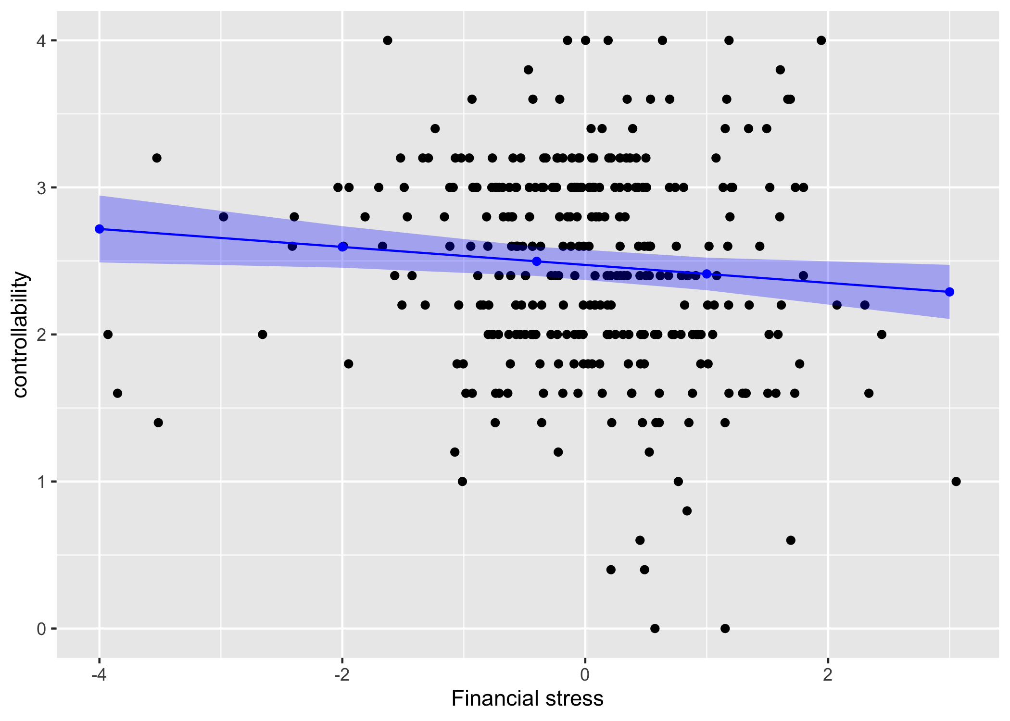

Slide 25
Conclusions
Based on the controllability linguistic markers, it is important for the patients to reflect their symptoms in a personal and meaningful way although there might be risk that immerse writing can evoke negative emotions. When controlled for participants and their baseline controllability scores and education, patients who are confident and motivated, tend to release negative emotions, and make great efforts to fight cancer in general are more likely to have better control of their symptoms. Those who are experiencing stress from employment and finance are more likely to do poorly in symptom control.
25

Slide 26
Implications
In contrast to f2f intervention where patients engage with materials in a structured and monitored way, and clinicians directly observe patients behavior and provide feedback, in digital intervention, it is important to target the limited clinician’s attention to patients who need it most.
The linguistic features identified in the message board can help clinicians monitor patient sense of control. By identifying patients who are likely to end up not improve their ability to control symptoms before it is too late, the clinicians can provide emotional support and tailor the content in time to help those patients control their symptom better.
f2f intervention
VS
Digital intervention

